Slide 1
Psychosocial Wellbeing, Depression & PTSD Among Adolescents with HIV
DR. WARIIMI KARINGI H118/42195/2022

Slide 2
Background
Adolescent mental health contributes significantly to disease burden.
High rates of depression/anxiety in SSA.
Adolescents are developmentally vulnerable.

Slide 3
Kenyan Context
Adolescents with HIV show lowest viral suppression.
High depression prevalence (44%).
Limited routine mental health screening.

Slide 4
Problem Statement
Burden of PTSD/depression among AHIV unknown.
Inadequate mental health services.
Stigma complicates care.

Slide 5
General Objective
Describe psychosocial wellbeing and determine prevalence of depression & PTSD among AHIV.

Slide 6
Specific Objectives
Identify factors associated with depression & PTSD.
Assess relationship with viral suppression & adherence.
Describe available mental health services.

Slide 7
Methodology
Cross‑sectional design.
Sample size: 128 adolescents.
Tools: standardized depression & PTSD screening.
Analysis: descriptive, bivariate, multivariate methods.

Slide 8
Sociodemographic Findings
53% female.
Most lived with parents/siblings.
95% currently in school.

Slide 9
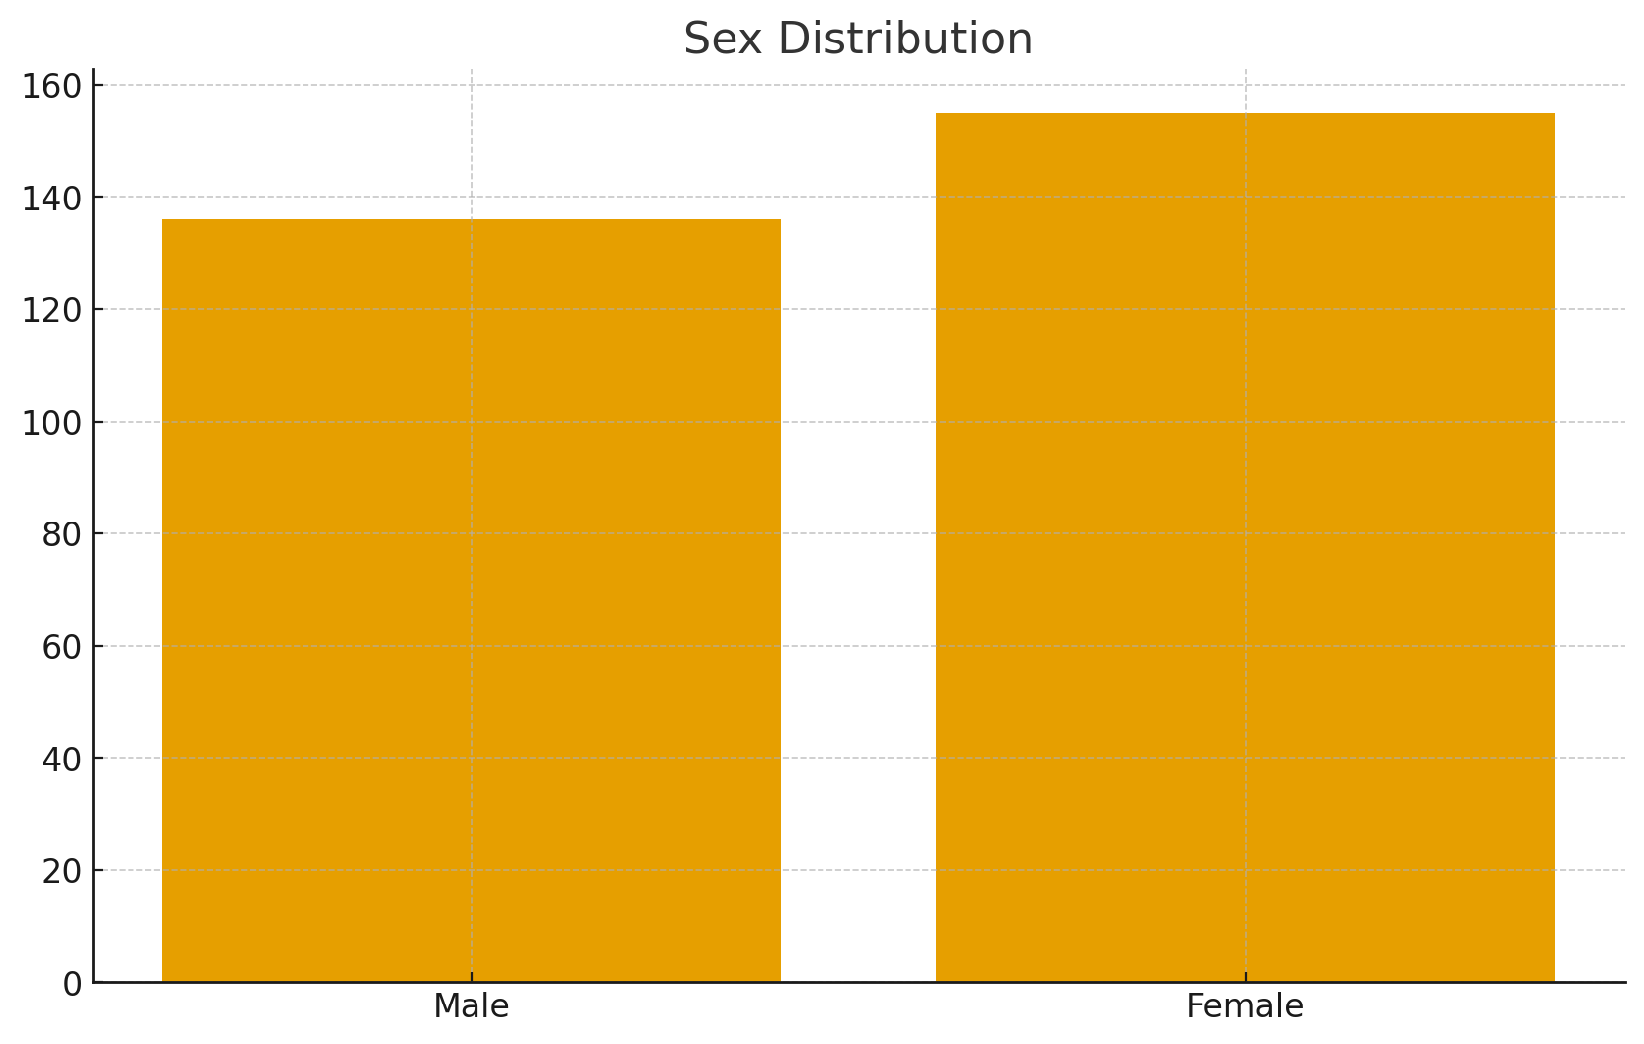
Sex Distribution

Slide 10
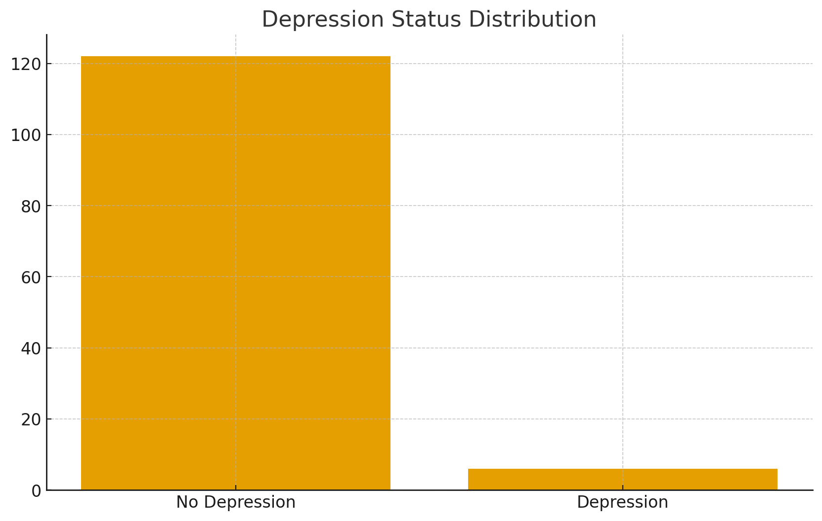
Depression Status Distribution

Slide 11
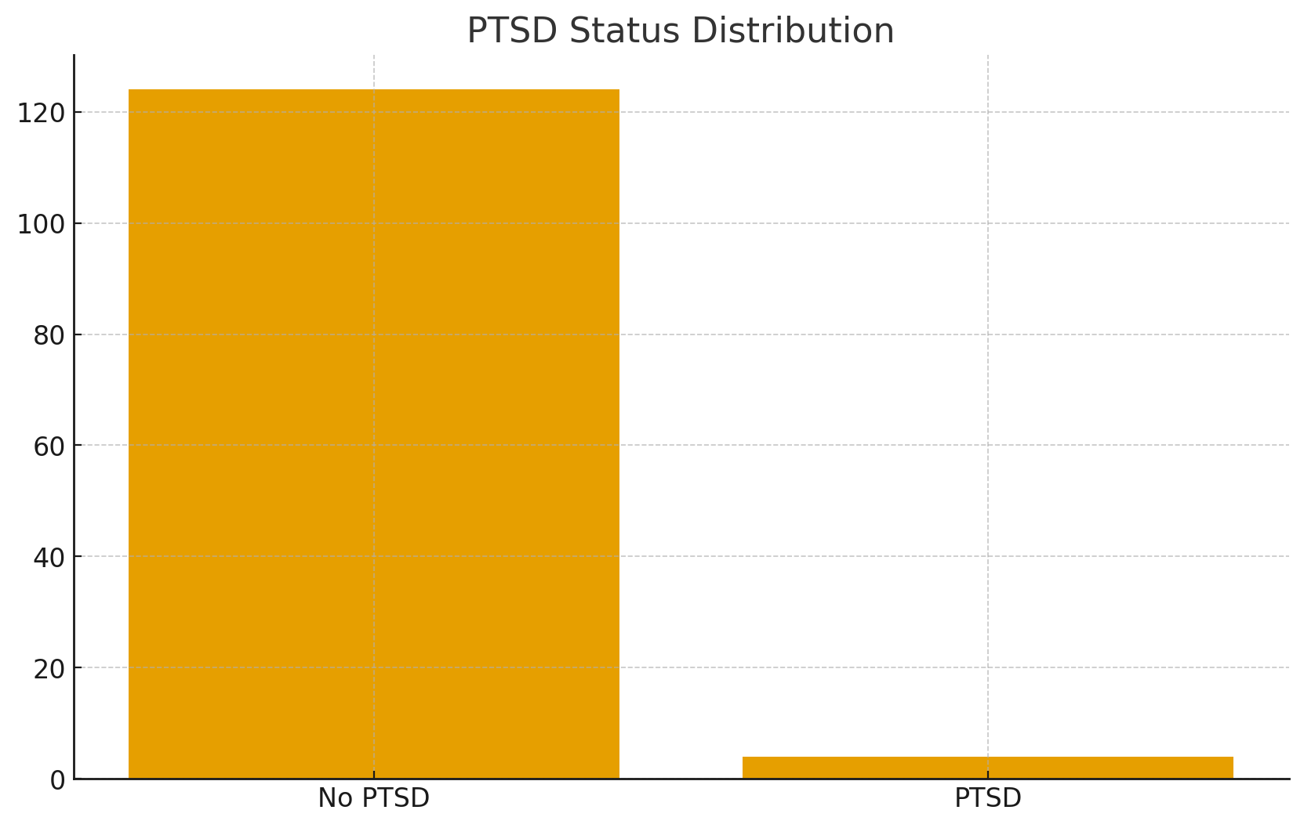
PTSD Status Distribution

Slide 12
Depression Symptoms Summary
Non‑depressed participants report nearly zero symptoms.
Depressed participants show clustered high‑frequency symptoms.
Suicidal ideation only in depressed group.

Slide 13
PTSD Symptoms Summary
Majority report no symptoms.
PTSD-positive show intrusive memories & hyperarousal.
Low but concentrated prevalence.

Slide 14
Bivariate Results – Depression
Significant factors: living arrangement, violence exposure, school attendance, social support.
No association with sex, residence, work, recent home changes.

Slide 15
Bivariate Results – PTSD
Significant: living arrangement, bullying.
Borderline: physical violence at home.

Slide 16
Multivariate Results – Depression
Living arrangement independently significant.
Physical violence borderline.
Violence at school loses significance when adjusted.

Slide 17
Interpretation
Family environment central predictor.
Violence exposure increases vulnerability.
Support systems protective.

Slide 18
Discussion
Low prevalence but high symptom concentration.
Strong relationship between home environment & mental health.
Need for integrated mental health screening.

Slide 19
Conclusions
Adolescents generally show good psychosocial wellbeing.
Minority affected by significant mental health challenges.
Living arrangement & violence are key predictors.

Slide 20
Recommendations
Strengthen family-based interventions.
Implement school-based mental health screening.
Improve anti-bullying programs.
Provide trauma-informed care.

Slide 21
Implications for HIV Care
Mental health impacts viral suppression & adherence.
Screening should be integrated into CCC.
Early identification improves outcomes.

Slide 22
Strengths of the Study
Use of standardized tools.
Sample from real-world CCC setting.
Multilevel analytic approach.

Slide 23
Acknowledgements
Supervisors and academic mentors.
Healthcare workers in Ruiru Subcounty.
Study participants.

Slide 24
Questions Slide
Thank you for listening!
Questions & Discussion.

